Slide 1

Usability of Interactive Systems/ Usability Motivations
Copyright © 2005, Pearson Education, Inc.

Slide 2
Background
Online business failures are increasing as customers turn away from unusable or unfriendly sites. ‘Build it and they will come’ mentality has led to the demise of e-commerce sites when sites are too late, too buggy, or too complex.
-- Becker and Mottay, 2001
In a poorly designed EC environment, users might be uncomfortable with the uncertainty and ambiguity caused by lack of interaction with websites. --Jahng et al, 2000
The number of shoppers and total sales are still marginal, mainly because of poor interfaces
        --- Jarvenpaa and Todd, 1997

Slide 3
Background
Building a usable website is important since website is the only source for online customers to touch, feel, search, communicate, and experience the products or services available at the online store
Usable websites
  Build positive attitude (Singh and Dalal, 1999)
  Increase stickiness (Rettie, 2001)
  Increase revisit rates (Klein, 1998)
  Increase online purchase (Palmer, 2002)
  Increase performance (Nielsen, 2000)
  Provide more satisfaction (Lund, 1999)

Slide 4
Agarwal and
Venkatesh (2002)
Content
Ease of Use
Promotion
Made-for-the-medium
Emotion
Palmer (2002)
Download Delay
Navigability
Information Content
Interactivity
Responsiveness
Kim et al. (2002)
Firmness
Convenience
Delight
McKinney et al.
(2002)
Access
Usability
Entertainment
Hyperlinks
Navigation
Interactivity
Zhang and
von Dran (2002)
Content
Enjoyment
Privacy
User empowerment
Visual appearance
Technical Support
Navigation
Credibility
Organization

Slide 5
Download
Delay
Download
Delay
Navigability
Navigability
Information
Content
Perceived
Success
Information
Content
Perceived
Success
Interactivity
Interactivity
Responsiveness
Responsiveness
Palmer (2002)

Slide 6
Motivation of the Study
Current inconsistency and incompleteness among website is the crucial problem
And actually speaking there is no way to measure it. Entire journey depends on the persons age, education,experience, attitude, social interaction etc. etc.
Usability measurement of the websites is again a very critical issue under usability studies.
There is very little in the way of concrete measurement that tells us how good a website really is. Current guidelines, methods, and metrics do help to design better websites, but there is room for improvement
- Tarasewich (2000)

Slide 7
Introduction
Usability combines knowledge and methods associated with professionals including:
  Psychologists (incl. Experimental, Educational, and Industrial Psychologists)
  Computer Scientists
  Instructional and Graphic Designers
  Technical Writers
  Human Factors and Ergonomics Experts
  Anthropologists and Sociologists
Copyright © 2005, Pearson Education, Inc.

Slide 8
The overall system acceptability
Social Acceptability
Practical Acceptability
  Reliability
  Cost
  Compatibility
  Usefulness
    Utility
    Usability
Copyright © 2005, Pearson Education, Inc.

Slide 9
The overall system acceptability
  Usefulness (issue of whether the system can be used to achieve desired goal or not)
    Utility (whether the functionality of a system in principal can do what is needed or not)
    Usability (depends on how well users can use that functionality)
Copyright © 2005, Pearson Education, Inc.

Slide 10
Usability Measures
5 Aspects
1. Time to learn
  How long does it take a typical member of your user community
  to learn how to use the UI in order to perform the defined tasks?
2. Speed of performance
  How long does it take to perform the benchmark tests?
Copyright © 2005, Pearson Education, Inc.

Slide 11
Usability Measures
3. Rate of errors by users
  How many and what kind of errors do users make in carrying out
  How much time required to rectify these errors?
4. Retention over time
  How well do users maintain their knowledge of how to use ?
  Is it customizable?
Copyright © 2005, Pearson Education, Inc.

Slide 12
Usability Measures
5. Subjective satisfaction
  How much did users like the UI or certain aspects of it?
Copyright © 2005, Pearson Education, Inc.

Slide 13
Usability measures (cont.)
Commonly it is tough to perform equally well in all of the 5 objectives; there are trade-offs
Example: The use of shortcuts or abbreviations increases the time to learn but also increases the speed of performance
  You need to determine which of the 5 measures are most important for your specific project and community
Copyright © 2005, Pearson Education, Inc.

Slide 14
Usability measures (cont.)
It is very hard to get all usability measures up to highest level for all kinds of systems.
Trade-offs in design options frequently occur.
Changes to the interface in a new version may create consistency problems with the previous version, but the changes may improve the interface in other ways or introduce new needed functionality.
Copyright © 2005, Pearson Education, Inc.

Slide 15
Usability Motivations
Many current UIs are still designed poorly
However, well-designed UIs can bring great benefits to the user and other stakeholders
There are 5 distinct groups of systems/ applications that each have distinct characteristics and that each provoke specific motivational aspects for usability
Copyright © 2005, Pearson Education, Inc.

Slide 16
Types of systems
Life-critical systems
Industrial and commercial systems
Home/entertainment systems
Exploratory, creative and collaborative Systems
Sociotechnical Systems
Copyright © 2005, Pearson Education, Inc.

Slide 17


Life-Critical Sysytems
Copyright © 2005, Pearson Education, Inc.

Slide 18
Usability Motivations
Life-critical systems
  Air traffic control
  Nuclear reactors
  Power utilities
  Police & fire dispatch systems
  Medical instruments
Copyright © 2005, Pearson Education, Inc.

Slide 19
Usability motivations
Life-critical systems
  Lengthy training periods are acceptable (well motivated professionals)
  Subject satisfaction is less an issue due to well motivated users
  Retention is not a problem ( a specific group/ can be attained by frequent use)
  Speed of performance (High) (crucial)
  Rate of errors (not acceptable) (crucial)
  High costs, reliability and effectiveness are expected (High reliability and effectiveness is a must)
Copyright © 2005, Pearson Education, Inc.

Slide 20
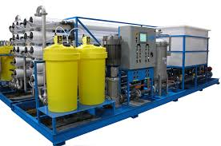

Industrial and commercial Systems
Copyright © 2005, Pearson Education, Inc.

Slide 21
Usability motivations (cont.)
Industrial and commercial uses
  Banking,
  Insurance,
  Order entry,
  Inventory management,
  Reservation,
  Billing, and point-of-sales systems
(e.g, SAP, PeopleSoft), etc.
Copyright © 2005, Pearson Education, Inc.

Slide 22
Usability motivations (cont.)
Industrial and commercial uses
Ease of learning is important to reduce operator training costs (as the system is highly depended on this category)
Error rates (Reliability) should be low (are relative to cost but not as crucial as it is with life-critical systems)
Speed of performance is important because of the large no. of number of transactions (faster operating speed potentially increases the organization’s profit)
Copyright © 2005, Pearson Education, Inc.

Slide 23
Usability motivations (cont.)
Industrial and commercial uses
  Subjective satisfaction is fairly important to limit operator burnout
  Retention over time can be retained by frequent use.
Copyright © 2005, Pearson Education, Inc.

Slide 24
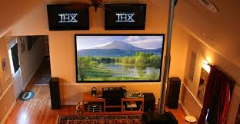
Home and Entertainment Applications
Copyright © 2005, Pearson Education, Inc.

Slide 25
Usability motivations (cont.)
Office, home, and entertainment applications
  Word processing
  Electronic mail
  Computer conferencing
  Video game systems
  Educational packages
  Search engines
  Mobile device, etc.
Copyright © 2005, Pearson Education, Inc.

Slide 26
Usability motivations (cont.)
Office, home, and entertainment applications
Should be easy to learn
Should have low error rates
Should be produced at low costs (due to high competition)
Subjective satisfaction is important
Retention should be supported by use of “easy-to-remember” procedures and online-help
Some critical issues: Due to High competition, commonly quick user frustration, user frequencies sometimes very low, very diverse communities, choosing adequate extent of functionality is difficult
Copyright © 2005, Pearson Education, Inc.

Slide 27
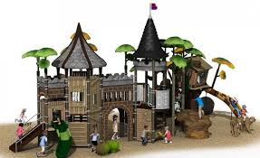
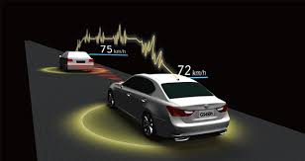
Exploratory, Creative and Co-operative systems
Copyright © 2005, Pearson Education, Inc.

Slide 28
Usability motivations (cont.)
Exploratory, creative, and cooperative systems
  Web browsing,
  Search engines
  Artist toolkits
  Architectural design
  Software development
  Music composition, and
  Scientific modeling systems
Copyright © 2005, Pearson Education, Inc.

Slide 29
Usability motivations (cont.)
Exploratory, creative, and cooperative systems
User is commonly familiar with the task domain, Motivation is high,
Expectations are high,
Usage-rate: occasional to frequent
Challenge: It is hard to describe/define benchmark
tests because of the exploratory nature of these
applications; in general: such applications are difficult to design and evaluate!
Copyright © 2005, Pearson Education, Inc.

Slide 30
Usability motivations (cont.)
Exploratory, creative, and cooperative systems
  Easy to learn --- high to moderate
  Speed of performance
  Subjective satisfaction – very high
  Rate of errors – high
  Retention over time – moderate
Copyright © 2005, Pearson Education, Inc.

Slide 31
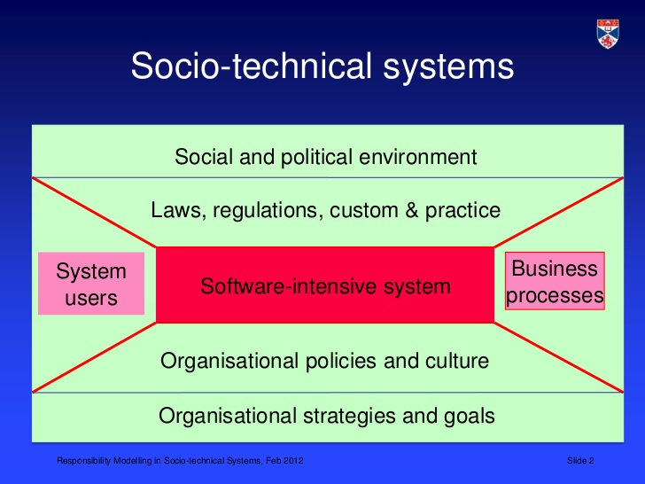
Social-technical systems
Copyright © 2005, Pearson Education, Inc.

Slide 32
Usability motivations (cont.)
Social-technical systems
  Complex systems that involve many people over long time periods
  Voting
  Health support
  Identity verification
  Crime reporting, etc.
Copyright © 2005, Pearson Education, Inc.

Slide 33
Usability motivations (cont.)
Social-technical systems
  Trust, privacy, responsibility and security are issues
  Verifiable sources and status feedback are important
  Ease of learning is important for novices and feedback to build trust
  Administrators need tools to detect unusual patterns of usage (important to reduce chances of malicious tampering or provision of incorrect information)
  Ease of learning is crucial
  Retention over time
  Rate of errors
  Subjective satisfaction
Copyright © 2005, Pearson Education, Inc.

Slide 34
Usability motivations (cont.)
Social-technical systems
  -- Performance – moderate
  Need to provide appropriate feedback (e.g., voting system)
  Users may be extremely diverse (novice and inexperienced users)
Copyright © 2005, Pearson Education, Inc.

Slide 35
Usability measures (cont.)
It is advisable to identify/understand and to communicate specific UI design goals/objectives and the respective trade-offs to product managers and/or clients (e.g., if speed of performance is crucial, emphasize that the operational productivity of the UI will be better in favor of possibly longer learning times)
Copyright © 2005, Pearson Education, Inc.

Slide 36
Thanks
Copyright © 2005, Pearson Education, Inc.

